Slide 1





All About Me
Year 7 Health
Lesson 7
2024

Slide 2

In the first 5 minutes of each lesson you will complete your revision page, you will find these throughout your booklet.
The revision page consists of three questions. It will need to be completed in detail. One word answers will not be accepted.
The three questions :
What two concepts or ideas did I learn in class last week?
What did I find interesting about last week’s lesson? Provide a specific example.
Any questions or new words you have learnt?
The teacher will go over this each lesson with you to see what you have learnt. It is a great way for you to revisit content and test your memory.
Notes:
Pg27

Slide 3
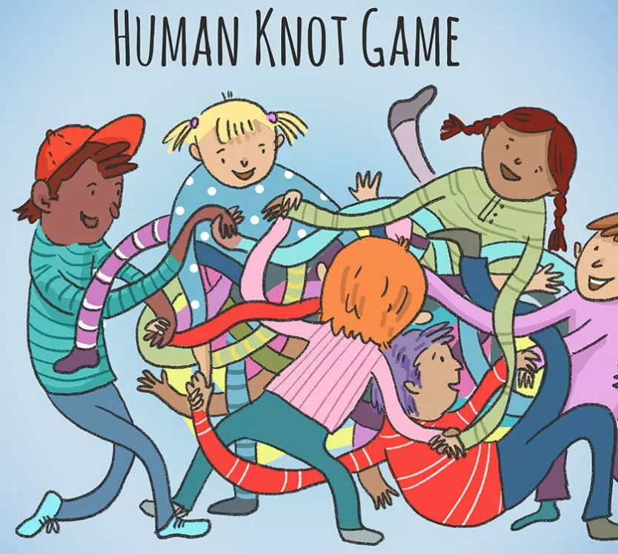
HOOK: (Pg. 28) Human knot
In groups of at least 6 students.
Stand in a circle.
Reach across and hold hands with two different people – they cannot be directly next to you.
CHALLENGE:
Untangle your knot without letting go of each other.

Slide 4

Human knot: REFLECTION questions (Pg. 28)
Answer the following questions in your book
What challenges did you face while trying to untangle the human knot? How did you overcome them?
How did effective communication help in unravelling the human knot? Can you give specific examples?
What role did teamwork play in successfully untangling the human knot? How did each team member contribute to the process?
Did you notice any patterns or strategies emerging within your team during the activity? How did these patterns contribute to your success?
What did you learn about the importance of listening during the human knot activity? How did active listening help in the process?
How did trust play a role in untangling the human knot? Did you feel more confident and comfortable as the activity progressed? Why or why not?
Reflecting on the communication within your team, were there any instances where miscommunication occurred? What impact did it have on the activity, and how could it have been avoided?
How did you feel when you successfully untangled the human knot? How did the experience of overcoming the challenge together as a team make you feel?
Notes:
Students can answer these in their books or teacher to facilitate as a class discussion.

Slide 5
Activity 1: Time management (Pg. 29)
Time management can be used to help us reduce stress and build resilience, and in turn, get things done!!
You will be working in small groups of 3-4. Each group will receive an A3 piece of paper.
Brainstorm skills you can use to help you manage your time.
You have 5 minutes.
We will go through answers for you to put into your books.
Time Management Skills
(to reduce stress and build resilience)
Notes:
Equipment – A3 paper, one per group.

Slide 6
Activity 1: Brainstorm – Time management (pg.29)
Break large tasks into small steps
Set SMART Goals
Specific
Measurable
Achievable
Realistic
Timely
To-do lists
Have a plan of attack
Prioritise and Plan
Identify order of importance
Time Management Skills
(to reduce stress and build resilience)
Avoid Procrastination
Set strategies to help you avoid this
Evaluate what works for you
Reflect and Adjust
Reach out for help when you need it
Activities that promote relaxation and well-being
Take Breaks and Practice Self-care
Rest and recharge
Seek Support
Make changes where needed
Notes:
Assessment 2 related
Prioritize and Plan: Make a to-do list or use a planner to prioritize tasks and activities. Identify the most important and urgent tasks and allocate time for them. Planning ahead helps create a sense of control and reduces the likelihood of feeling overwhelmed.
Set SMART Goals: Set Specific, Measurable, Achievable, Relevant, and Time-bound (SMART) goals for yourself. Break larger tasks into smaller, manageable steps, and set deadlines for each step. This approach helps you stay focused, motivated, and organized.
Avoid Procrastination: Recognize and address procrastination tendencies by using strategies like setting deadlines, breaking tasks into smaller steps, using timers, and rewarding yourself for completing tasks. Overcoming procrastination reduces stress and builds resilience by promoting a proactive and efficient approach to tasks.
Seek Support: Recognize that you don't have to do everything on your own. Reach out for help or support when needed. Collaboration and seeking assistance when appropriate reduce stress and enhance resilience by distributing the workload.
Take Breaks and Practice Self-Care: Incorporate regular breaks into your schedule to rest and recharge. Engage in activities that promote relaxation and well-being, such as meditation, deep breathing exercises, physical exercise, hobbies, or spending time with loved ones. Self-care boosts resilience by enhancing physical and mental well-being.
Reflect and Adjust: Regularly review your time management strategies and evaluate their effectiveness. Identify areas for improvement, learn from your experiences, and adjust your approach as needed. Continual reflection and adjustment help refine your time management skills and build resilience over time.

Slide 7
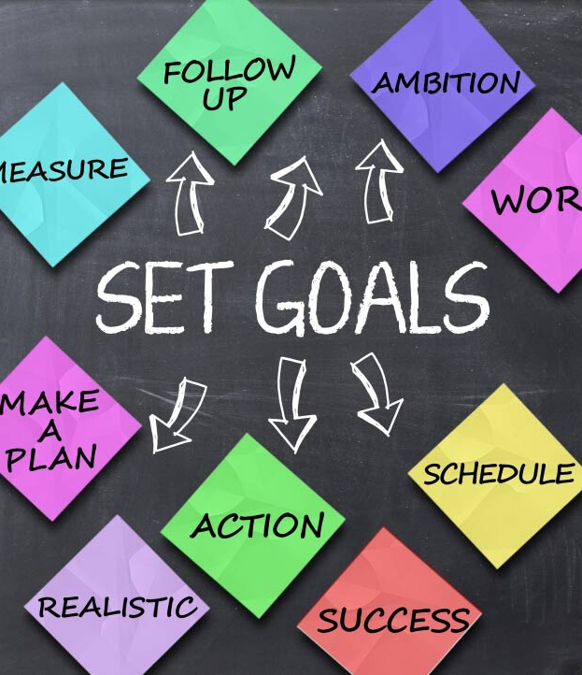
Activity 2: Goal Setting & Resilience (Pg. 30)
If you read the biographies of elite sports people, actors, political and world leaders, they all talk about their dreams and goals. Having short-term as well as long-term goals is a great way to help you realise your full potential, and can give you a focus in your life, today and into the future.
Goal setting is important for resilience as it helps to keep us motivated and on track with what we want to achieve.
Planning our goals also helps us to stay on track when obstacles strike!
While watching the video:
List the 4 easy steps for goal setting.
Write one sentence to describe each.
You will have a few minutes after to converse with the person next to you to add anything you may have missed before sharing with the class.
What is the BONUS tip?
Notes:
Assessment 2 related
Answers:
Choose your big goal – know what you really want to achieve.
Have a purpose – why do you want to achieve your goal? Keeps you motivated.
Break it down into small steps – break it down to make it easier to achieve and measure.
What are the obstacles? – plan for the obstacles that may occur.
BONUS – write it down – monitor your progress and make adjustments as necessary.

Slide 8

Notes:
https://www.youtube.com/watch?v=a4jnPQD7pO8
Pg30

Slide 9
Clarity and Direction:
Setting goals provides clarity and direction in life.
Helps to stay focused and motivated, even during challenging times.
Motivation and Persistence:
Goals give something to strive for and a reason to push through difficulties.
Having a clear goal in mind helps to stay determined and persevere through setbacks.
Growth and Adaptability:
The process of setting and pursuing goals often involves stepping out of your comfort zone and embracing new experiences.
Sense of Control:
Setting goals provides a sense of control over your own life which helps enhance your sense of agency and self-efficacy.
Celebrating Milestones and Progress:
Goal setting allows the celebration of milestones and progress.
Each achievement reinforces resilience and boosts motivation.
Problem-Solving Skills:
Challenges faced require you to find creative solutions, adapt your strategies, and persevere in finding ways to move forward.
Positive Mindset:
When you set meaningful goals, you shift your focus from obstacles and setbacks to possibilities and progress.
GOAL SETTING
& how it helps with building RESILIENCE
Fill in the blanks on Pg.31 to give reasons why goal setting if good for building resilience.
Notes:
Assessment 2 related
Read through with the class and get them to fill in the blanks.
Pg.31

Slide 10
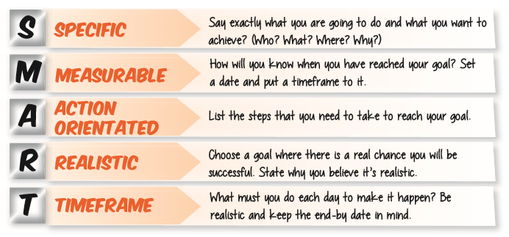
Activity 3: How to set s.m.a.r.t goals (Pg. 32)
Setting SMART goals helps us to create a goal that is clear to us and within our reach.
Fill in what each letter stands for.
Set one goal for yourself to achieve by the end of this term.
We will revisit this in week 9.
Notes:
Assessment 2 related
Measurable = how can we keep track of our progress
Achievable and action-oriented can be interchanged. Achievable is making sure we realise that it is within our reach, and we are aware of the steps/actions we need to take to get there.
Time frame = have a ‘due date’

Slide 11

GLOSSARY: (pg.5)
At the front of your books is your glossary.
Turn to your glossary and add your own definition for SMART GOALS.
Make sure your definition consists of at least two sentences.
Notes:
A comprehensive definition for goal setting will be useful for their Assessment Task 2.

Slide 12

EXIT TICKET: (pg.32)
What do you want to achieve by the end of this term?
Write yourself a S.M.A.R.T goal.
We will check your achievement at the end of the term.
Some suggestions to get you thinking include…
Be related to school
i.e., achieving above 75% in your next Health assignment.
i.e., bring my PE uniform to all my remaining lessons this term.
Be related to something personal outside of school
i.e., finishing a book that you are reading.
i.e., learning a new song on the guitar.
Whatever you choose for your goal, make sure it is SMART and it is something YOU want to achieve. Have a purpose!
Notes:
Allocate time at the end of the lesson to complete this.
Help students to ensure that it is meets all the SMART goal requirements. Use the template in their books to help breakdown their goal.

Slide 13

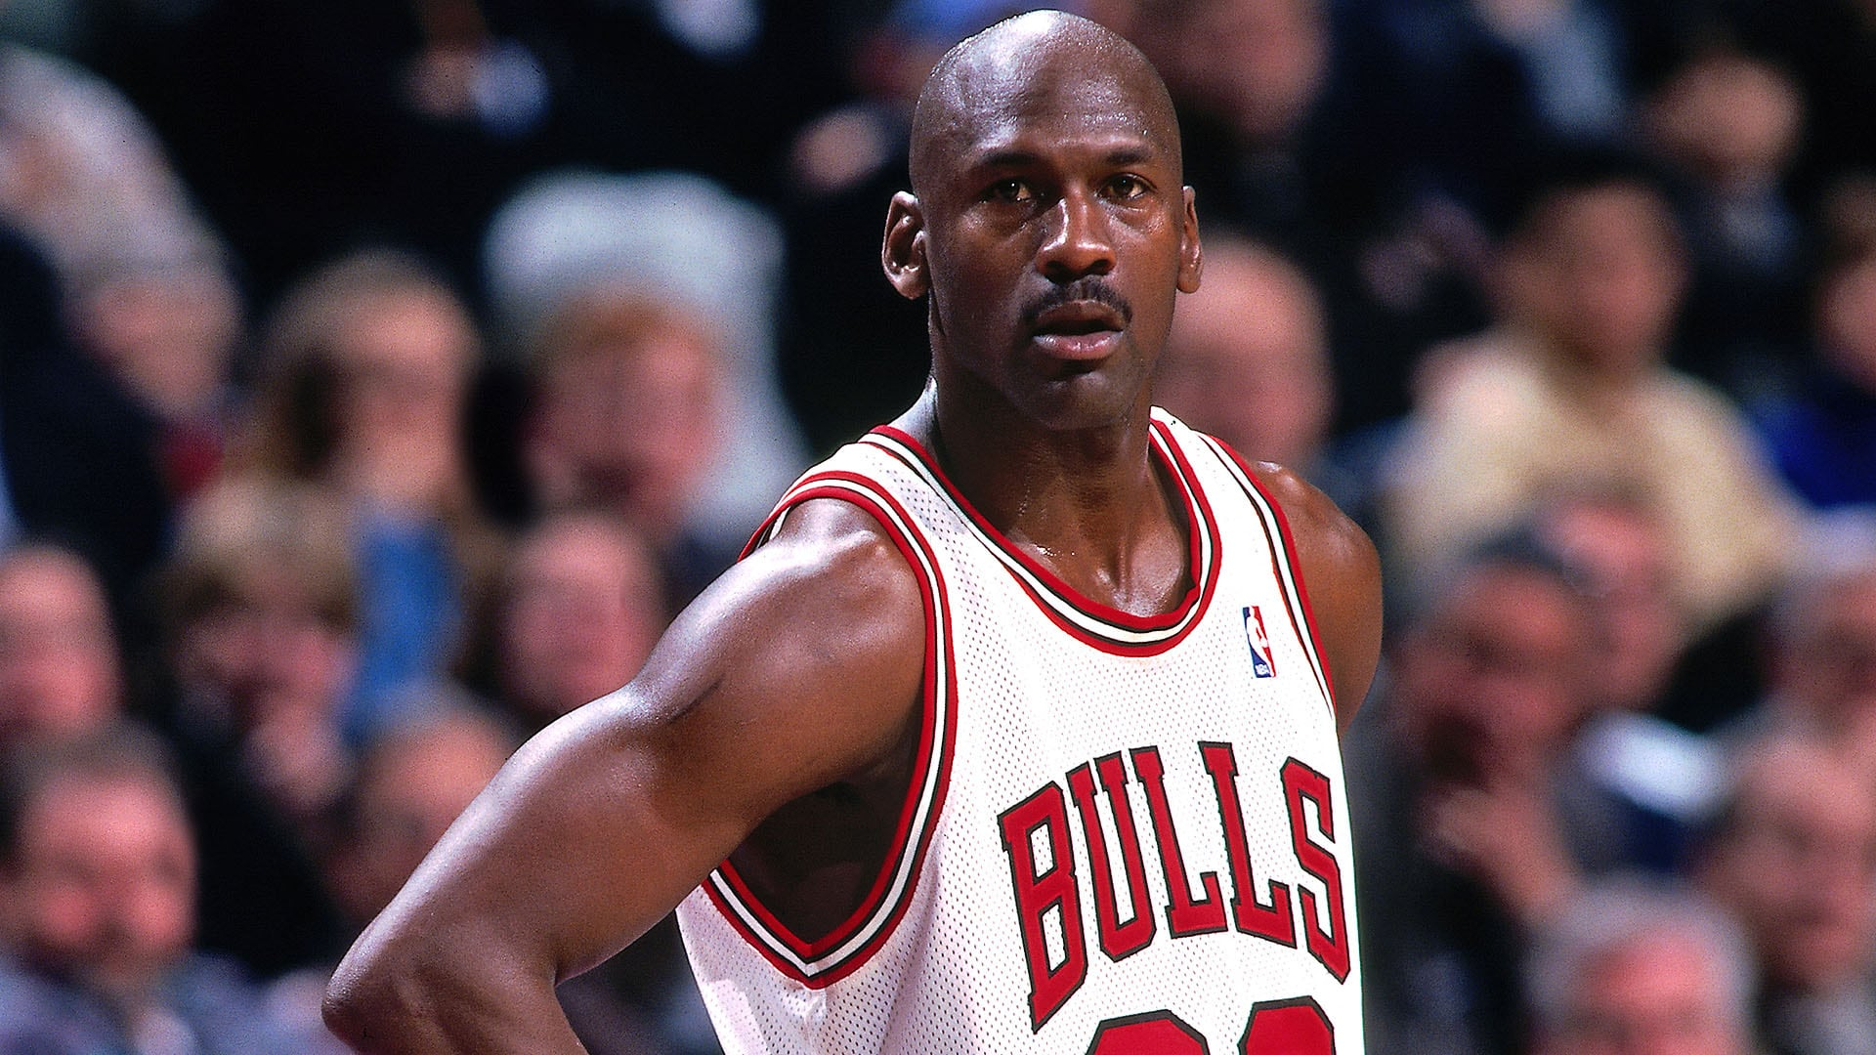

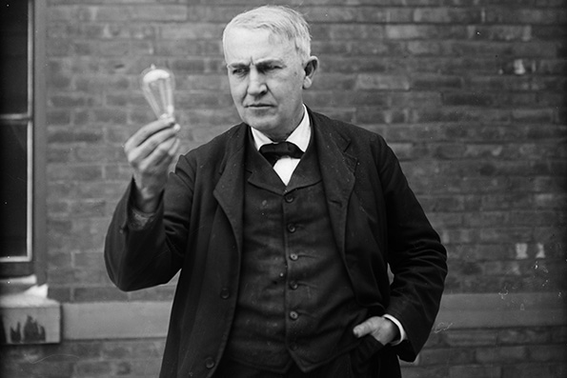

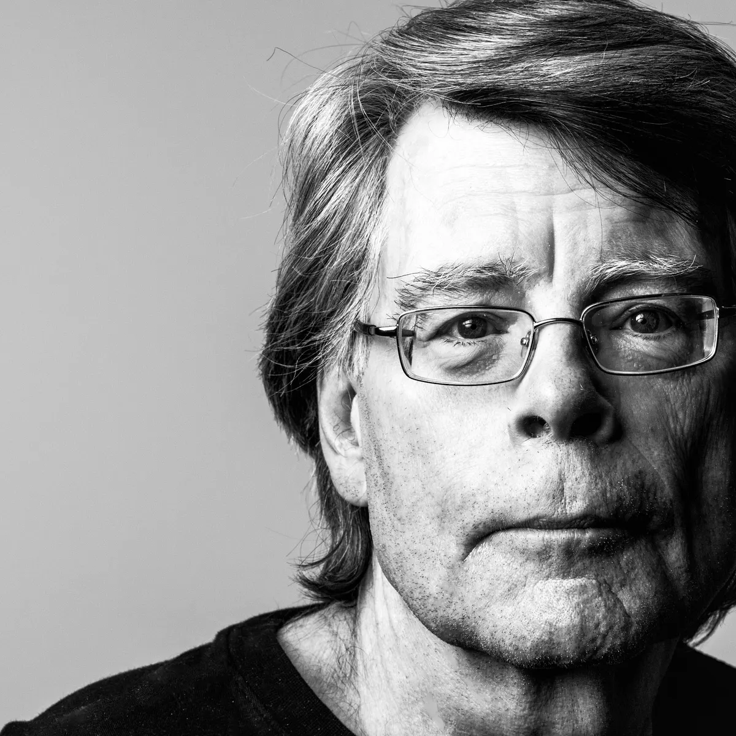
Optional activity: Case study (pg.33)
Activity – Research one of the below individuals who have experienced failure, however, demonstrated resilience to overcome a tough situation. Then answer the questions in your workbook.
J.K. Rowling: The author of the Harry Potter series faced numerous rejections from publishers before finally securing a publishing deal. Her determination and resilience allowed her to persevere and become one of the most successful authors of all time.
Michael Jordan: Widely regarded as one of the greatest basketball players, Jordan faced several setbacks early in his career, including being cut from his high school basketball team. However, he used these failures as motivation to work harder, eventually becoming a six-time NBA champion and an iconic figure in the sports world.
Oprah Winfrey: Despite a challenging childhood and early setbacks in her career, Oprah Winfrey went on to become one of the most influential media personalities in the world. She overcame obstacles and used her experiences to connect with audiences and build a successful media empire.
Thomas Edison: The renowned inventor is famously known for his resilience in the face of failure. It took him thousands of attempts before successfully inventing the practical electric light bulb. Edison once said, "I have not failed. I've just found 10,000 ways that won't work," highlighting his unwavering determination.
Serena Williams: The tennis superstar faced numerous obstacles throughout her career, including injuries and personal challenges. Despite setbacks, she consistently displayed resilience and a relentless work ethic, becoming one of the greatest tennis players of all time.
Stephen King: The acclaimed author received numerous rejection letters for his first novel, "Carrie." Despite the initial setbacks, King continued to write and eventually became one of the most successful and prolific authors in the world, with his books selling millions of copies worldwide.
Notes:
Optional activity to do in this lesson.
Alternatively this activity could be done in week 9, instead of more class time for the assignment.

Slide 14

Case study questions (pg.34-36)
What specific challenges or setbacks did the individual face?
2. How did the individual initially respond to the failure or setback?
What emotions do you think the individual might have experienced during that time?
3. What strategies did the individual use to cope with the failure and build resilience?
Did the individual seek support from others? If so, who did they turn to and how did that support help?
What role did perseverance play in the individual's journey to overcome the failure?
Were there any key moments or turning points where the individual's resilience was particularly evident?
How did the individual maintain a positive mindset despite facing failure?
9. Did the individual learn any important lessons from the failure? If so, what were they?
10. How did the individual use the failure as an opportunity for growth and personal development?
11. Can you identify any strengths or personal qualities that contributed to the individual's resilience?
12. How did the individual's resilience impact their future successes or achievements?
13. What can we learn from this case study about the importance of resilience in overcoming challenges?
14. How can we apply the lessons learned from this case study to our own lives when facing failures or setbacks?
15. What advice would you give to someone who is currently experiencing a failure and needs to develop resilience to overcome it?

